Slide 1

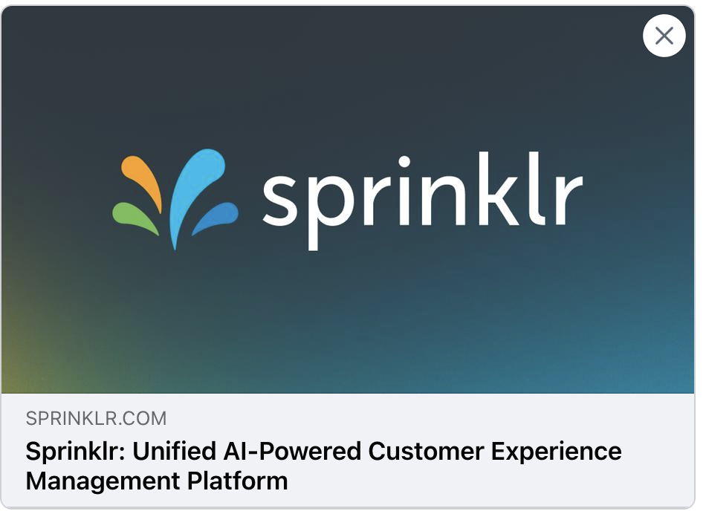
We all know the excitement of clicking a compelling link and finding amazing content!

Slide 2

DYNAMIC Link Previews for Enhanced Engagement
CHINMAY SHARMA T

Slide 3
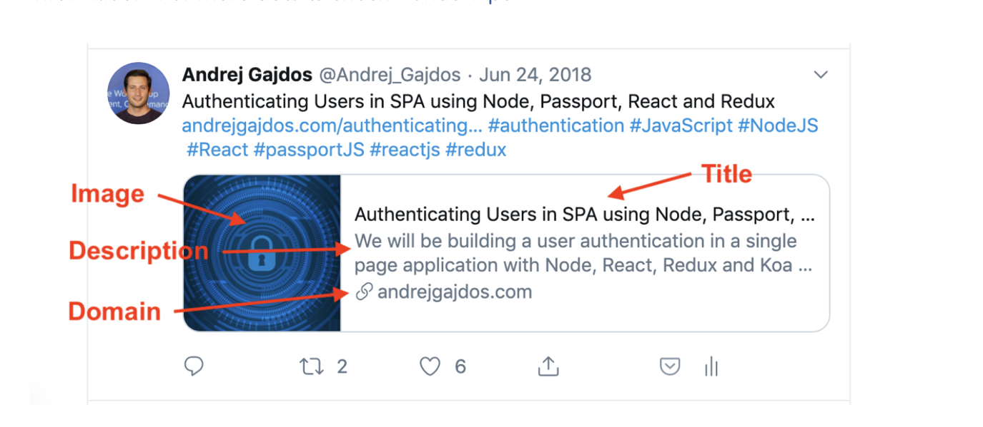
INTRODUCTION:
Developing a link preview scraper tool that extracts information from a given URL and generates a JSON-formatted preview of the content. The tool supports generating previews for LinkedIn, Facebook, and Twitter, and exposes an API endpoint for accessing the previews.

Slide 4


Slide 5
Static webpages and dynamic webpages
STATIC WEBPAGE | DYNAMIC WEBPAGE
1. In static web pages, Pages will remain same until someone changes it manually. | 1. In dynamic web pages, Content of pages are different for different visitors.
2. Static Web Pages are simple in terms of complexity. | 2. Dynamic web pages are complicated.
3. Static Web Page takes less time for loading than dynamic web page. | 3. Dynamic web page takes more time for loading.
4. Built using HTML, CSS, and sometimes JavaScript. | 4. Often built using server-side scripting languages like PHP, Python, Ruby, or JavaScript (Node.js).

Slide 6
IMPLementation – static webpages
Initiate HTTP GET Request: Start by using Jsoup to perform an HTTP GET request to the target webpage.
Jsoup's Capabilities: This library excels at parsing HTML, extracting data, and manipulating the document structure.
OG Tag Detection: Using Jsoup, the process involves checking the ‘<head>’ section of the HTML to verify the presence of Open Graph (OG) tags or Twitter cards (for Twitter).
Efficiency and Speed: This approach is both efficient and swift, making it ideal for initial checks and quick data extraction.

Slide 7
Implementation – dynamic webpages
Fallback Mechanism: If OG tags are not found(or incomplete) using Jsoup, Selenium WebDriver will be employed.
Page Navigation and Scraping: Selenium WebDriver will navigate and scrape the webpage.
Browser-like Rendering: Selenium WebDriver renders the page just like a real browser, enabling interaction with dynamic content.
Ensuring Information Retrieval: This approach ensures that even if OG tags are missing or dynamically loaded, the necessary information can still be retrieved.

Slide 8
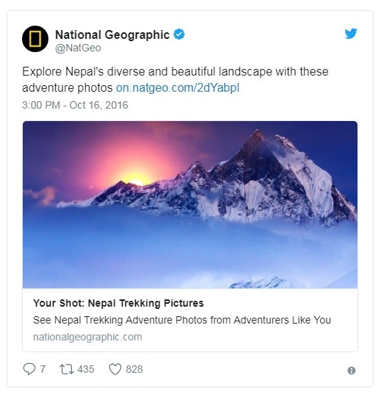
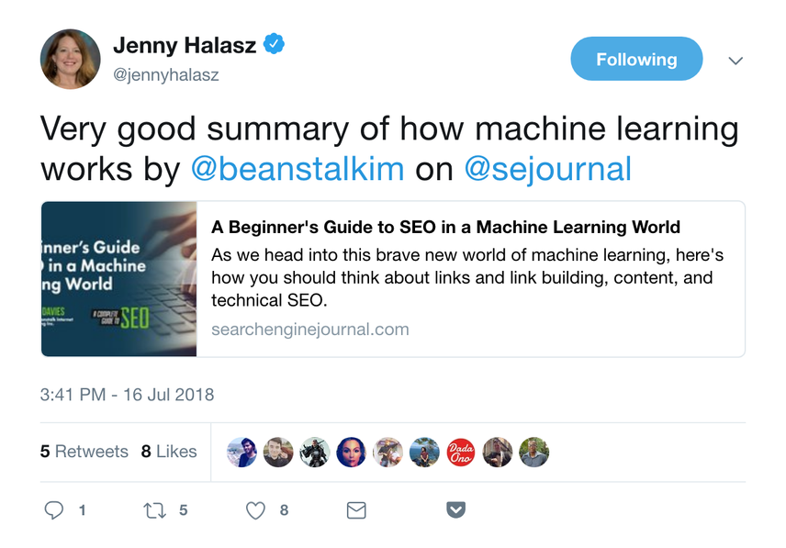
TWITTER

Slide 9
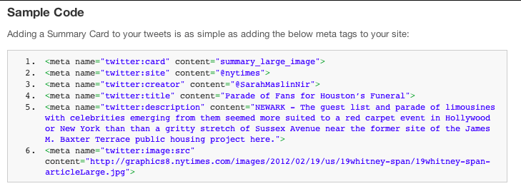
LOGIC FOR TWITTER:
Twitter Cards Check: When a link is shared, Twitter first looks for Twitter Cards metadata.
Fallback to OG Metadata: If Twitter Cards are missing, Twitter checks for Open Graph (OG) metadata.
Ensured Preview: This fallback ensures Twitter can generate a preview card even without Twitter Cards, using OG metadata if available.

Slide 10
Twitter cards
There are mainly 4 types of Twitter Cards, namely Summary Card, Summary card with large Image, App Card, and Player Card.
When a webpage includes Twitter Cards markup, it informs
Twitter how the content should appear when shared on the
platform.

Slide 11
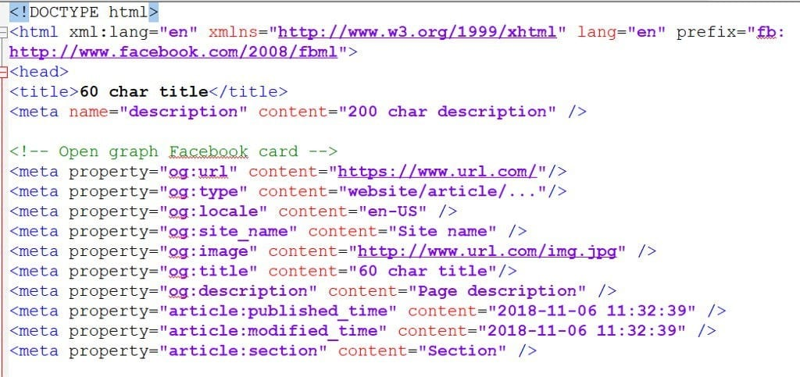
OPEN graph tags
Origin: Introduced by Facebook in 2010.
Definition: Metadata elements in the <head> section of HTML.
Purpose: Provide specific content information.
Adoption: Widely supported across social media platforms.

Slide 12
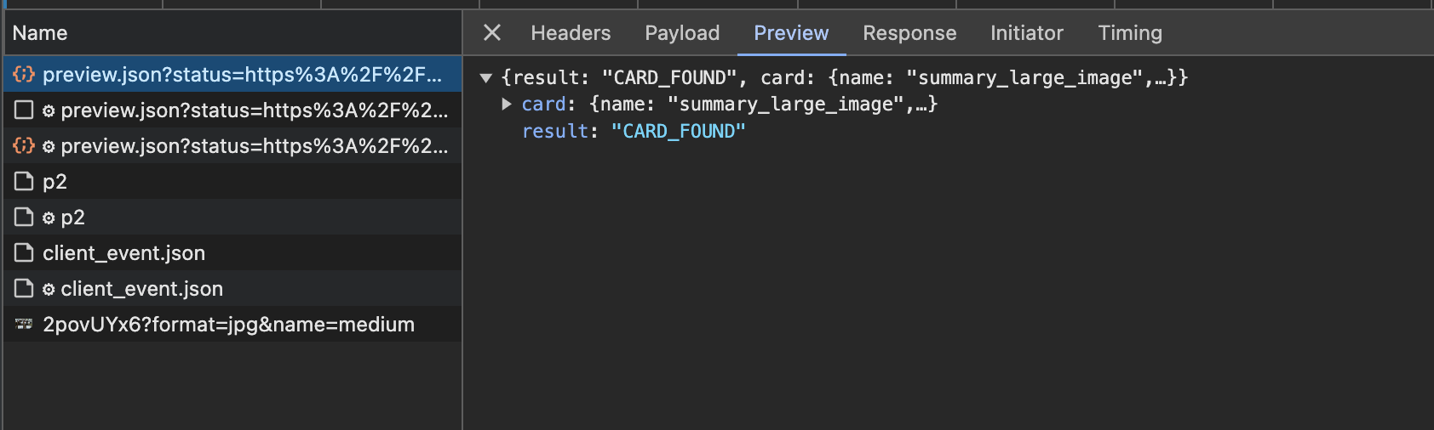
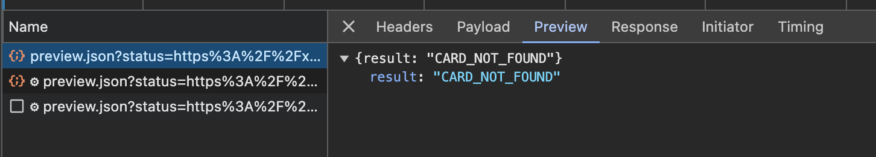
Network traffic analysis
After inspecting, I further analyzed the network tab. Initially, my system initiates an API call to check for Twitter Cards and OG tags. In the provided image, we can observe the response from the server when Twitter tags are present and absent.

Slide 13
NOTABLE FINDINGS:
Twitter first tries to access the Twitter Cards on the HTML page.
If Twitter Cards are absent(or incomplete), it tries to access Open Graph (OG) tags.
If there are multiple ‘og:image’ tags, it accesses the last ‘og:image’ tag on the page.
No fixed dimension limit for Twitter images. Image dimensions largely depend on the domain of the URL. Recommended image size for Twitter Cards is 1200x628 pixels for optimal display.

Slide 14
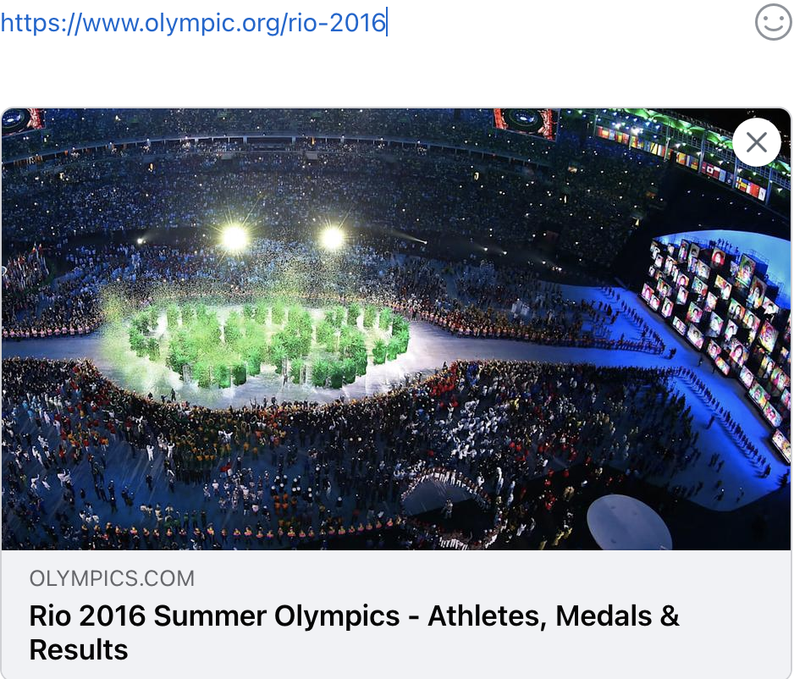
FACEBOOK

Slide 15
LOGIC FOR FACEBOOK
Facebook uses Open Graph (OG) tags to generate link previews. It checks for these tags in the webpage's metadata and utilizes their information for creating previews.
If OG tags are missing or incomplete, Facebook scrapes the webpage to gather additional information for generating a preview.
If an OG image tag exists but the associated image’s dimensions are less than 200x200 pixels, Facebook may disregard it as insufficient for a quality preview, and it may continue to scrape the webpage to find the first image above 200x200 pixels to preview it as the image.

Slide 16
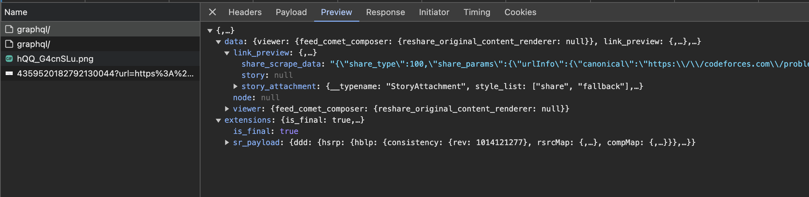
Network traffic analysis
Upon inspecting the network tab, we can observe that a GraphQL API call originating from my system directed towards an endpoint. It is seen that it applies a sorting algorithm to rank the images of the webpage, subsequently selecting the top-ranked image.

Slide 17
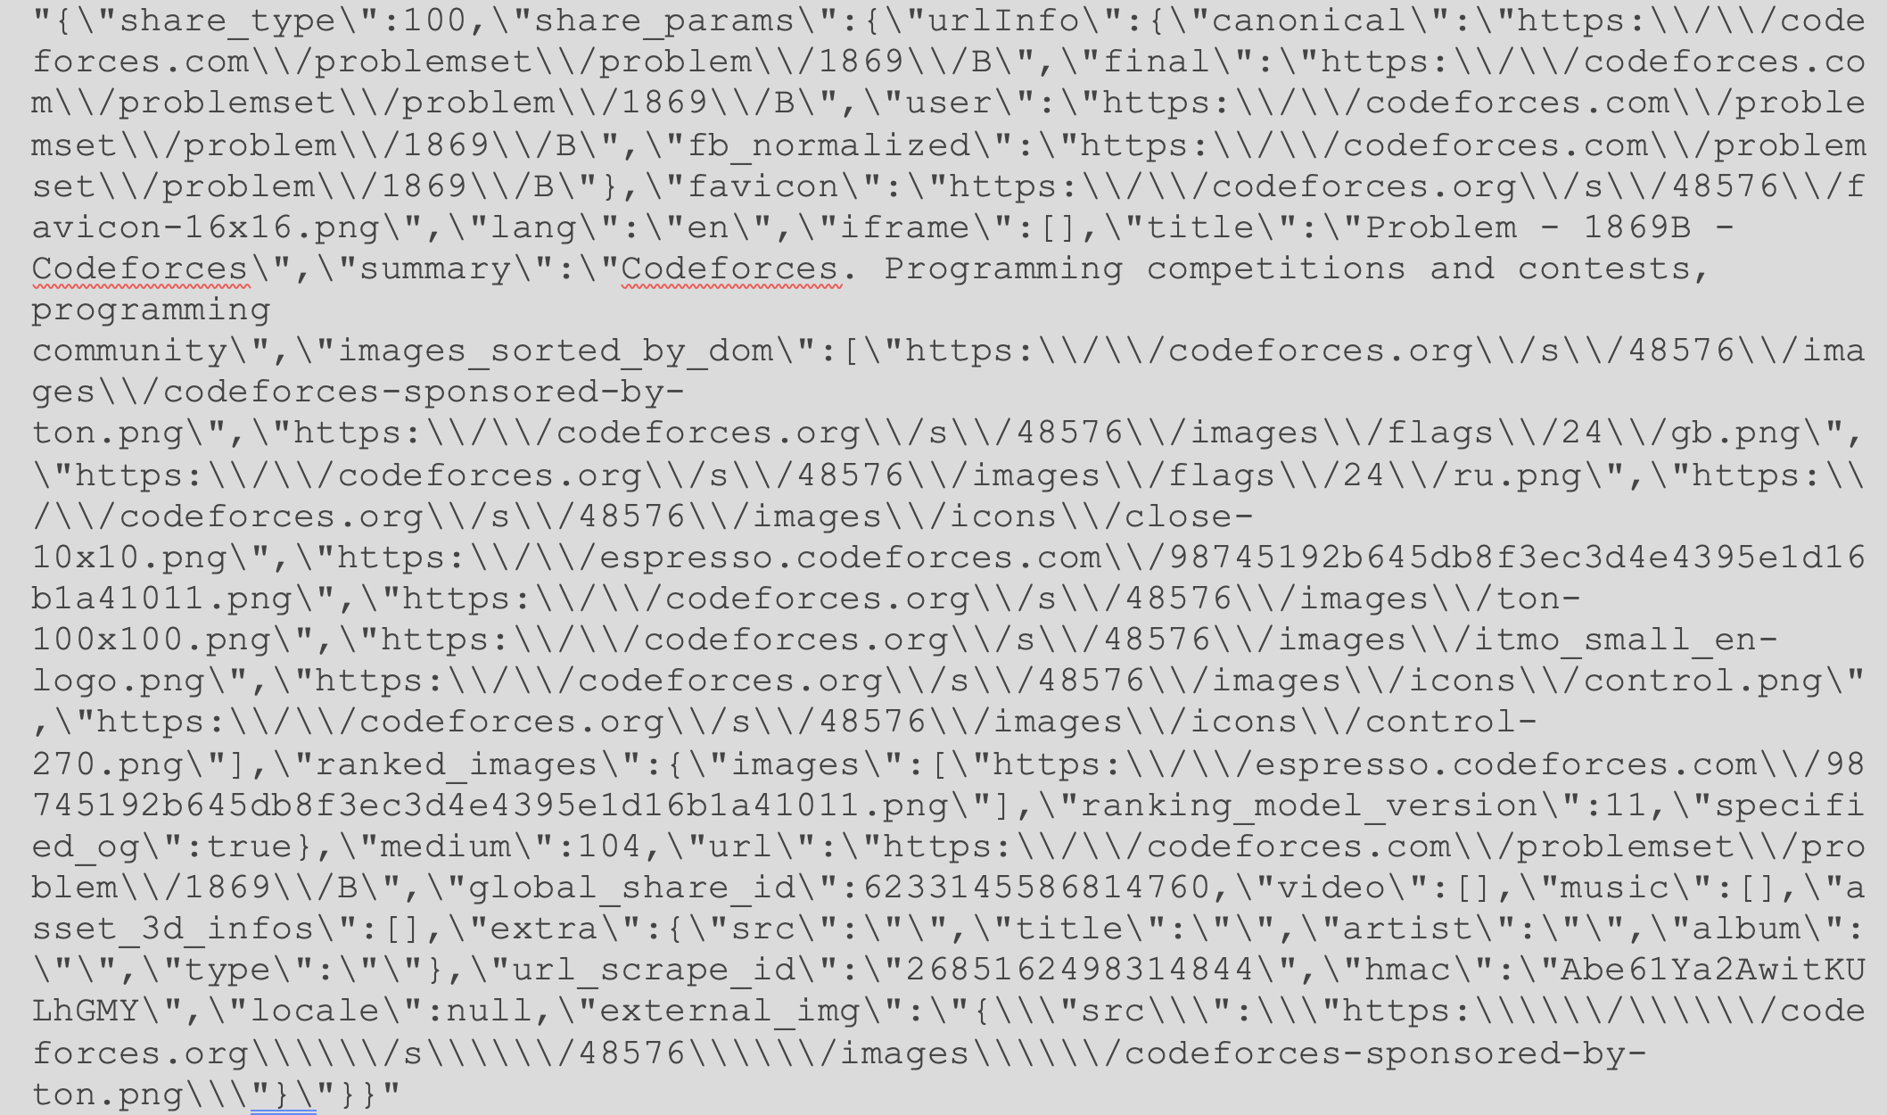

Slide 18
Notable findings:
Initially checks for the presence of OG tags in the webpage’s metadata.
If OG tags are absent or incomplete, Facebook scrapes the webpage to gather additional information for generating a preview.
If an ‘og:image’ tag exists but the associated image’s dimensions are less than 200x200 pixels, Facebook may disregard it. Facebook continues to scrape the webpage to find the first image above 200x200 pixels to use as the preview image.

Slide 19
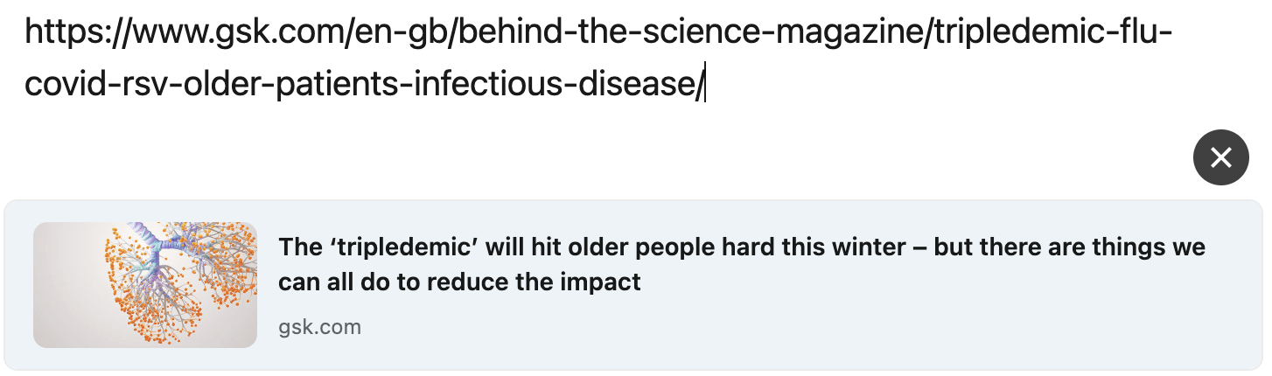
LINKEDIN

Slide 20
LOGIC FOR LINKEDIN
Initially, LinkedIn checks for Open Graph(OG) tags on the webpage. If OG tags are present, LinkedIn uses the information provided.
However, if OG tags are missing or incomplete, LinkedIn proceeds to scrape the webpage for images. During this scraping process, LinkedIn looks for the first image with dimensions greater than 120x120 pixels.
Unlike Facebook, LinkedIn doesn’t enforce a strict minimum dimension requirement for OG images.

Slide 21
caching
Caching is facilitated through a map, where URLs are linked with aggregated responses for efficient storage and retrieval.

Slide 22
Significant updates
Addition of ‘twitter:card’ in the Twitter response.
For dynamic webpages, the GET request through Jsoup can take longer due to frequent updates. Therefore, we've set a 4-second timeout for the GET request.
During the initialization of the driver for our tool, several options were integrated. This includes configuring a suitable user-agent specifically tailored for headless browsers, ensuring compatibility and optimal performance during web scraping tasks.
Tackled various exceptions including ‘og:image’ retrieval for Twitter, XPath for description extraction, and title handling.
The entire codebase has been restructured to adhere to SOLID principles, enhancing maintainability and scalability.

Slide 23
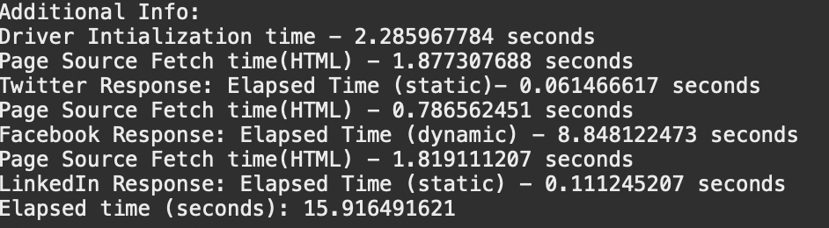
Timing Analysis for Code Segments
Comprehensive Analysis :
Static and dynamic sections of Twitter, LinkedIn, and Facebook were analyzed.
Precision Measurement :
Analysis conducted using a nanosecond timer available in Java.
High-Resolution Timer :
Enabled precise measurement of execution time for various code segments.
Detailed Insights :
Provided detailed insights into the performance characteristics of the link preview scraper tool.

Slide 24
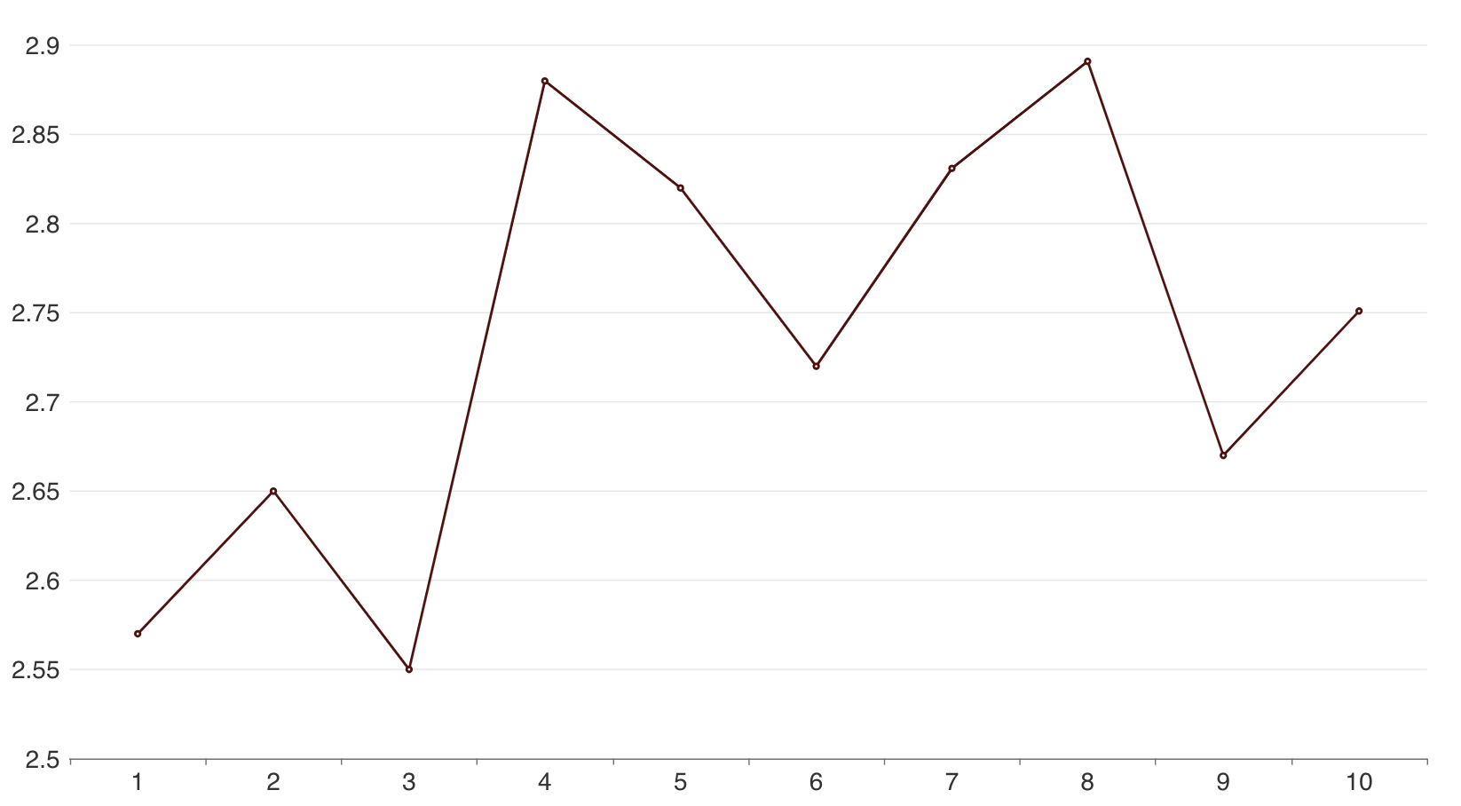
Web driver initialization time
The initial API call to the endpoint will initialize the web driver. Through multiple analyses, it was determined that driver initialization takes approximately 2.5 to 3 seconds.
Subsequent API calls benefit from this initialization, as the driver is initialized only during the first API call, saving time for subsequent requests.
Initialization time ~ 2.7s

Slide 25
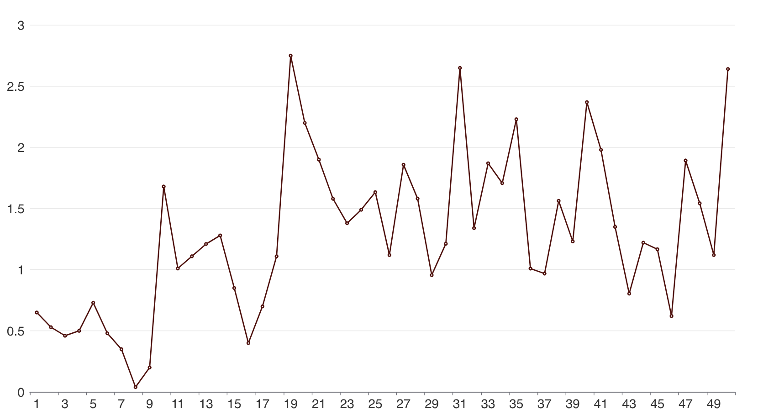
HTML Page Fetch Duration
Time < 4s
The GET request usually takes a few seconds, but dynamic pages can take longer due to updates.
A 4-second timeout is set; if exceeded, it switches to the driver method.

Slide 26
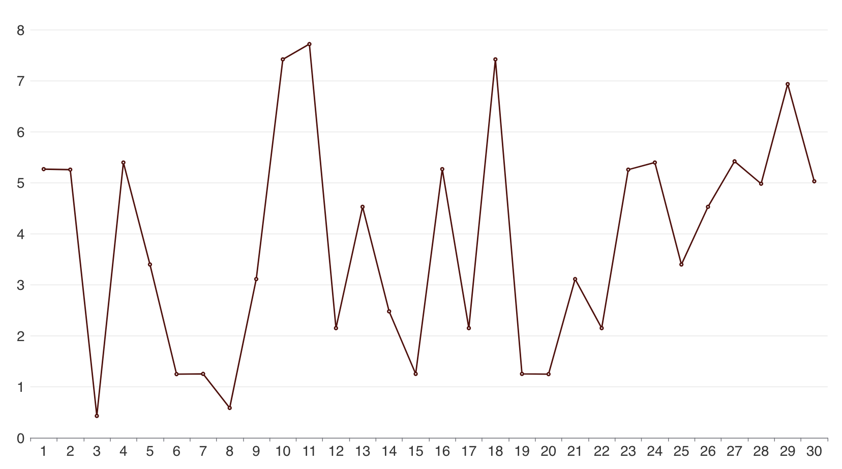
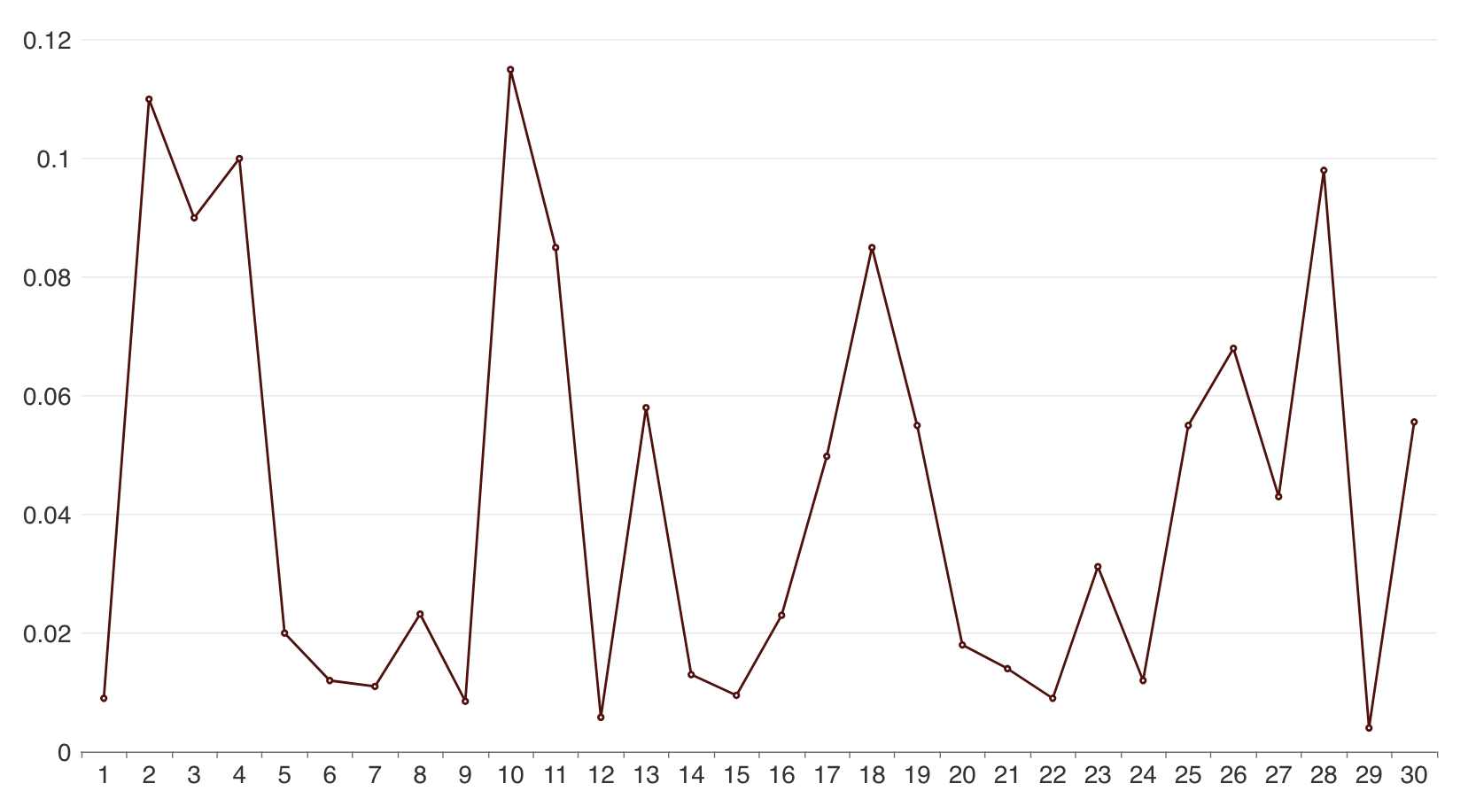
Twitter timing analysis
DYNAMIC
Dynamic pages generally take between 1 and 7 seconds to load.
Static pages typically load in about 0.01 to 0.12 seconds.
STATIC

Slide 27
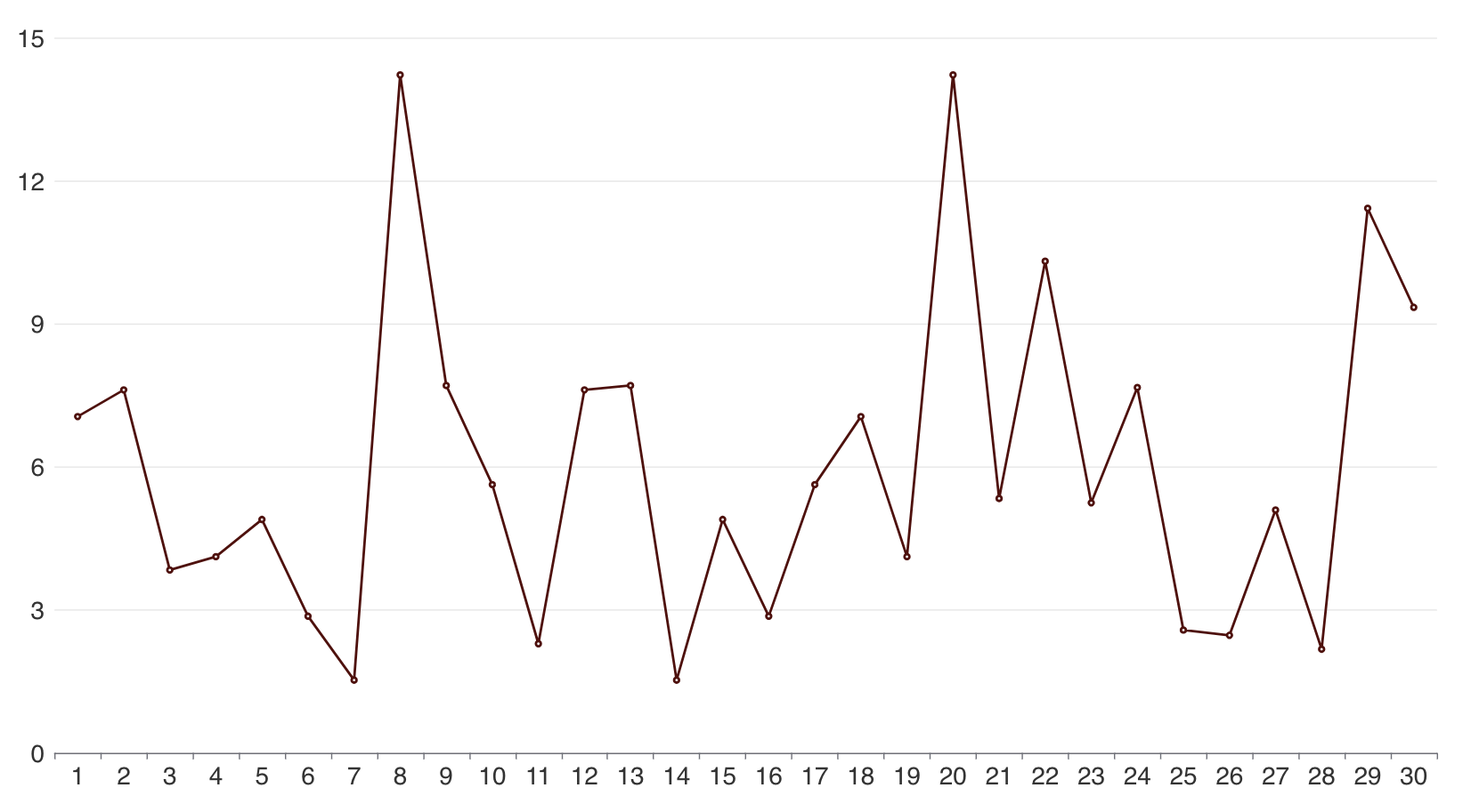
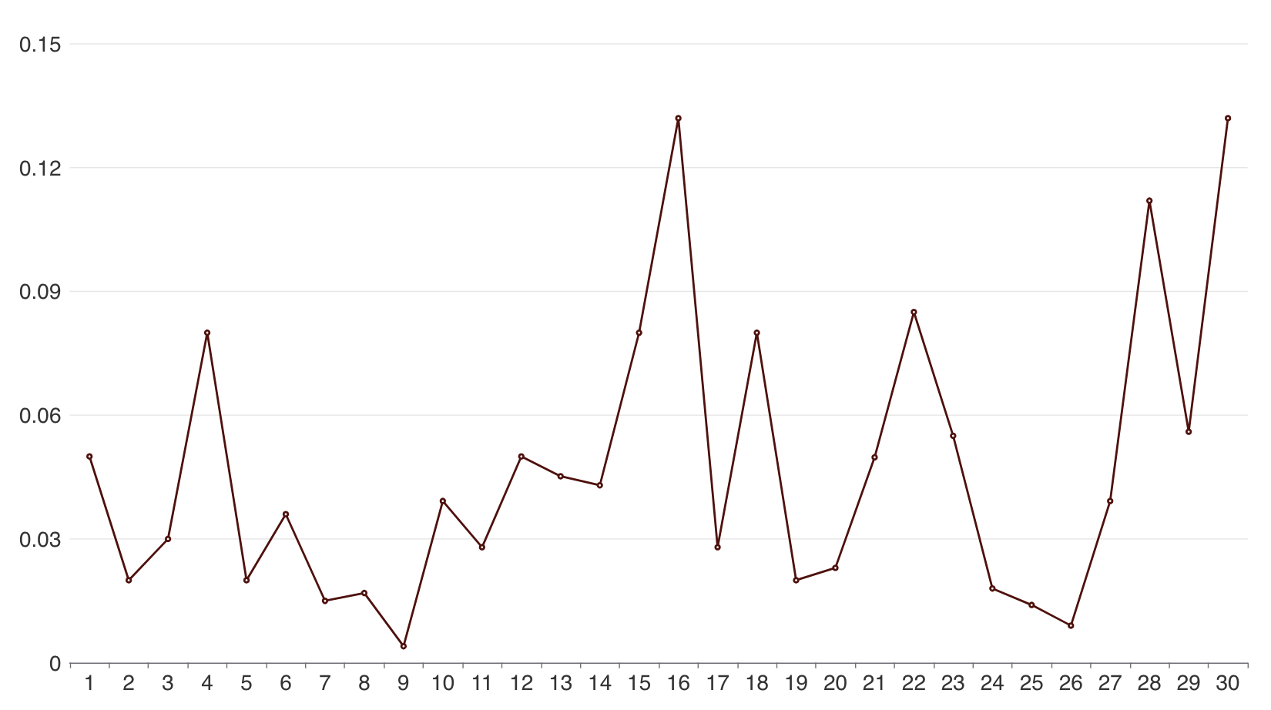
FACEBOOK timing analysis
DYNAMIC
Dynamic pages generally take between 2 and 15 seconds to load.
Static pages typically load in about 0.01 to 0.2 seconds.
STATIC

Slide 28
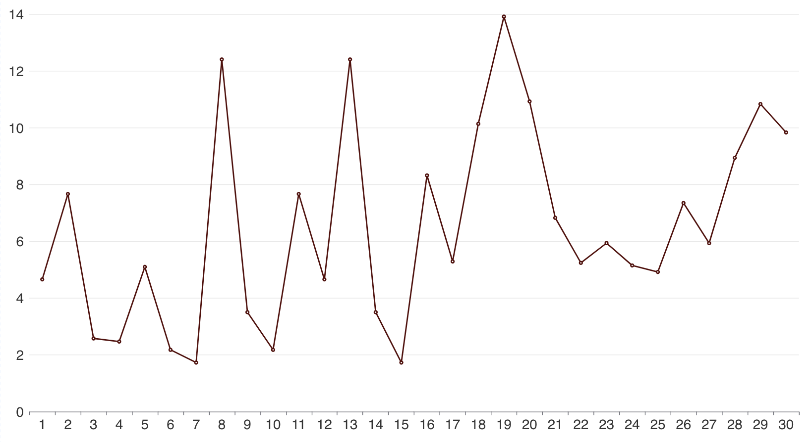
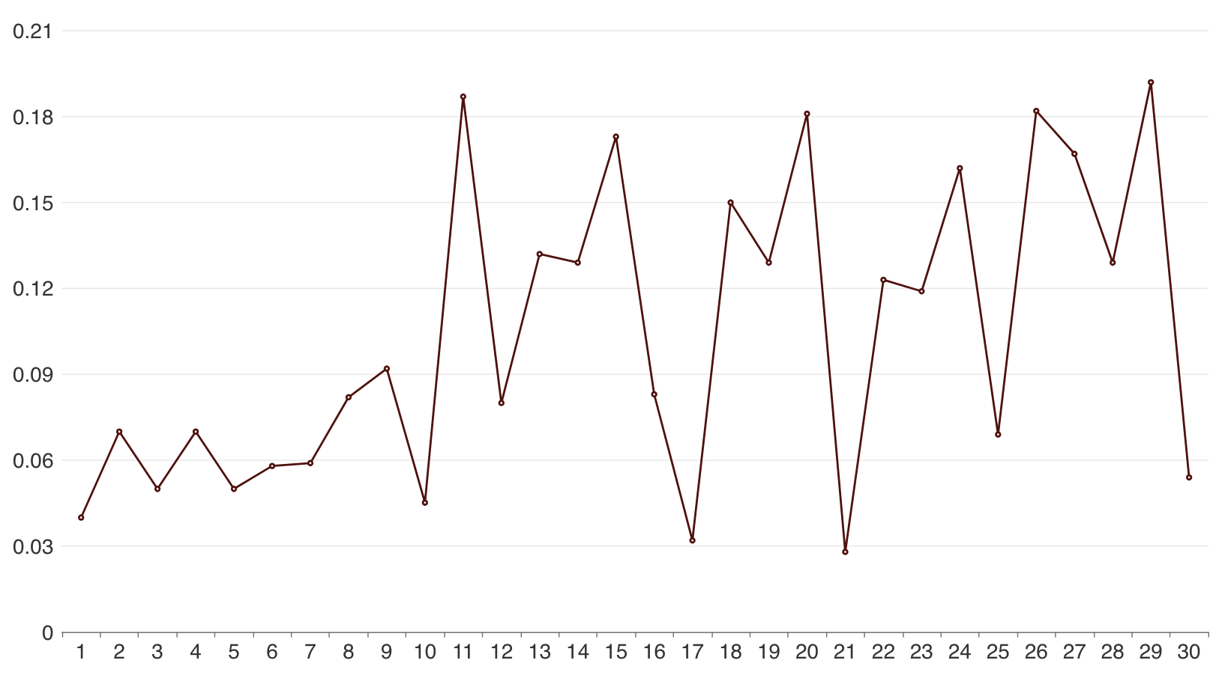
linkedin timing analysis
DYNAMIC
Dynamic pages generally take between 2 and 14 seconds to load.
Static pages typically load in about 0.01 to 0.25 seconds.
STATIC

Slide 29
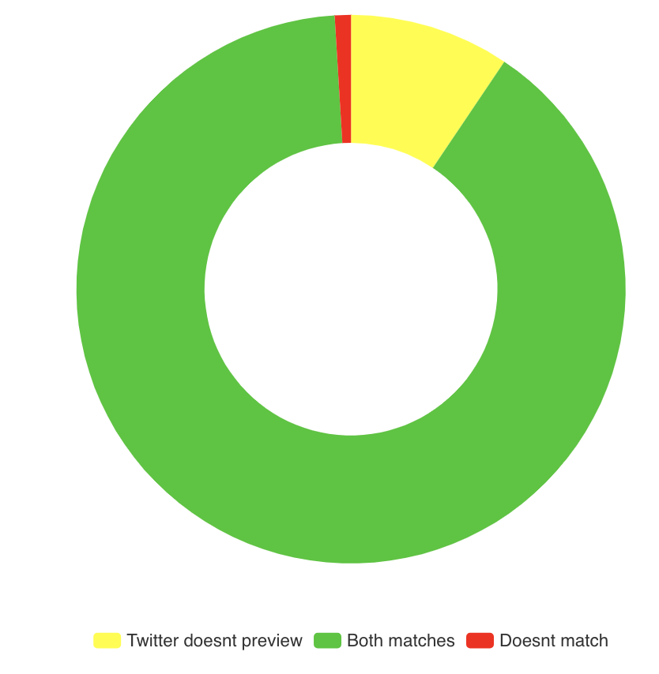
Twitter Accuracy based on test-set
0.009%
9.4%
Both Matches : 95 (89%)
Twitter doesn’t Preview : 10 (9.4%)
Doesn’t match : 1(0.009%)
89%

Slide 30
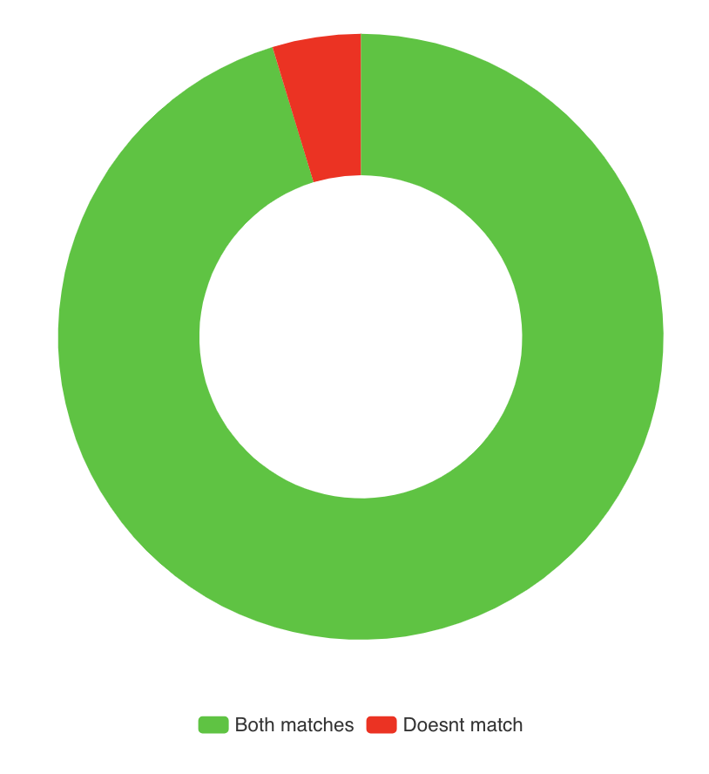
FACEBook Accuracy based on test-set
4.8%
Both Matches : 101 (95.2%)
Doesn’t match : 5 (4.8%)
95.2%

Slide 31
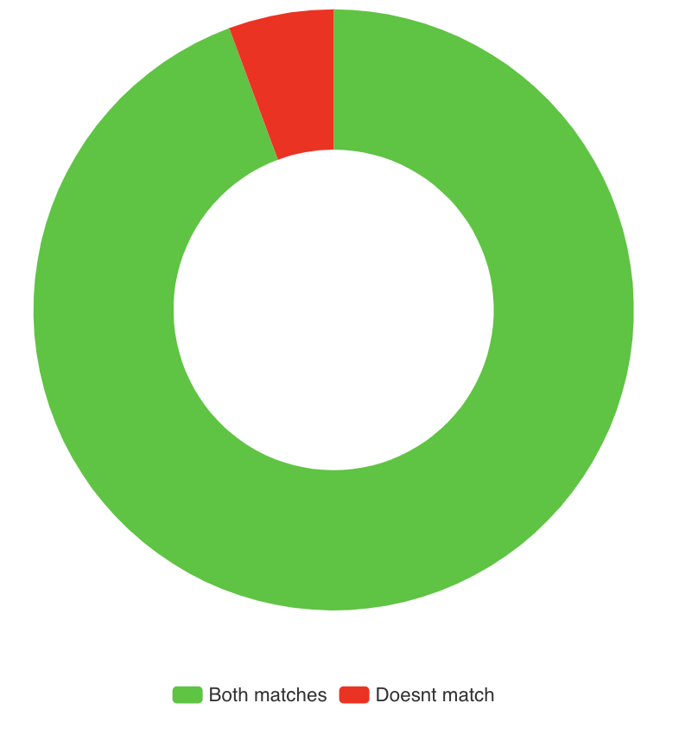
linkedin Accuracy based on test-set
5.66%
Both Matches : 100 (94.33%)
Doesn’t match : 6 (5.66%)
94.33%

Slide 32
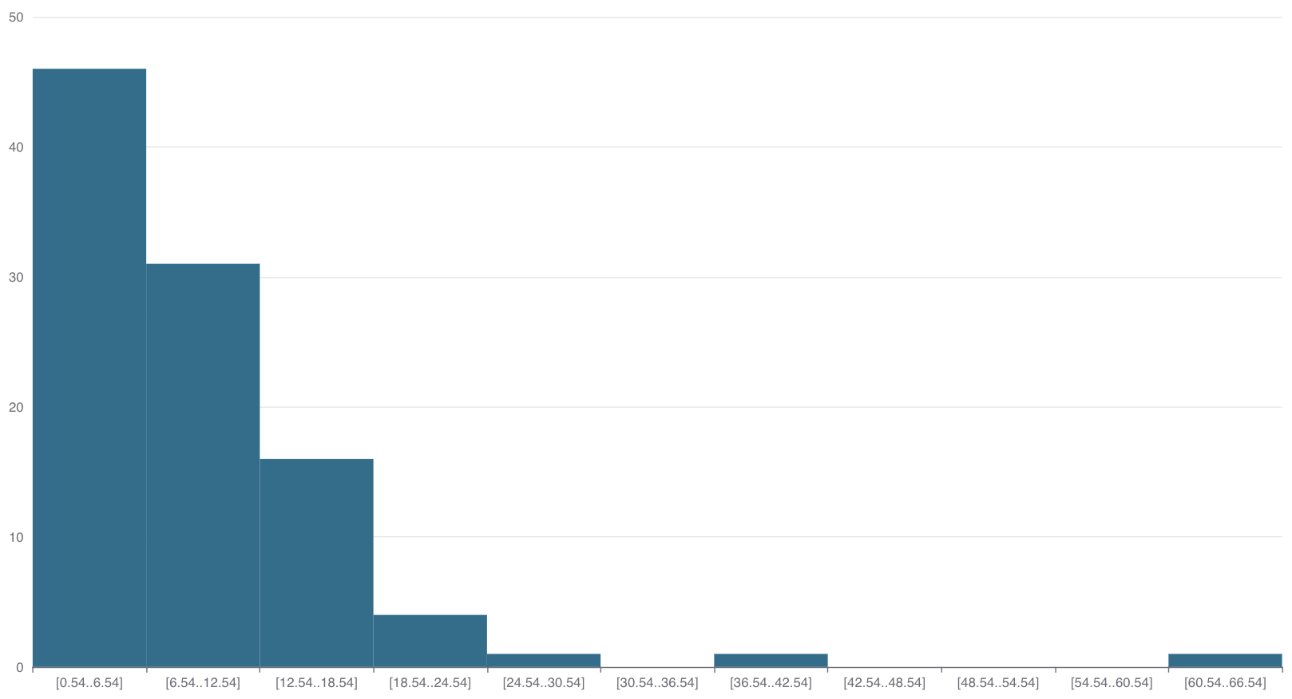
NUMBER OF LINKS VS TOTAL TIME TAKEN
46
Most static webpages are fetched in under 10 seconds.
Typically, dynamic webpages take about 10 to 30 seconds to fetch, depending on the time required to scrape the page using Selenium WebDriver.
31
17
3
1
1
1

Slide 33
Code execution demonstration
https://www.ndtv.com/india-news/neet-ug-2024-exam-paper-leak-supreme-court-sanctity-of-exam-affected-need-answers-supreme-court-on-neet-ug-row-5865003
https://www.msn.com/en-xl/news/other/how-china-supports-russia-s-war/ar-BB1mtV9d?ocid=hpmsn&cvid=15d182e75e85495685a3ae6faca657bb&ei=5
https://creditblog.capitalone.ca/latest-stories/good-terms-statements?external_id=WWW_ZFBLC_ZCV_ZZZZSE_ZZZAZ_NF_ZZ_Z_ART3

Slide 34
THANK YOU

